Slide 1
Removing High-­Density Impulse Noises from a Single Natural Image
國立臺北科技大學 電子工程研究所 博 士 班 畢 業 論 文 口 試
Student: Po-Hsiung Lin
Advisor: Prof. Shih-Chia Huang
Date: November 21th, 2020

Slide 2
Outline
I
Introduction
II
Previous Works
III
Proposed Method
IV
Experimental Results
V
Conclusions

Slide 3
Outline
I
Introduction
II
Previous Works
III
Proposed Method
IV
Experimental Results
V
Conclusions

Slide 4
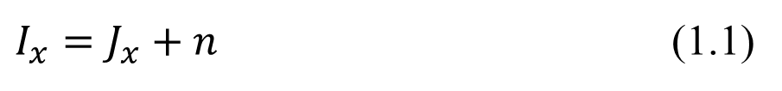
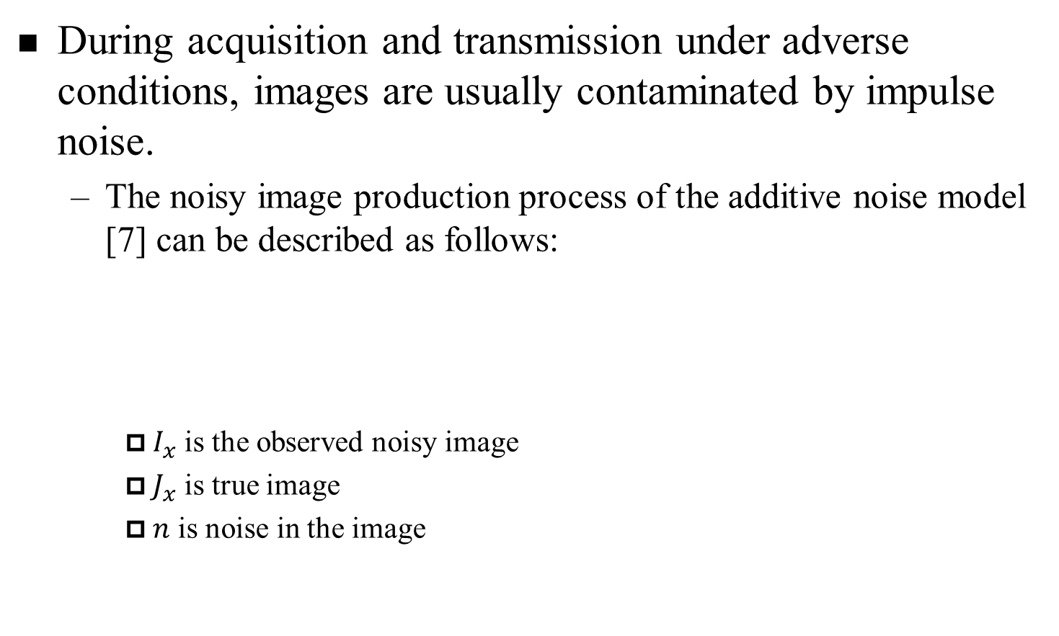
Introduction(1/6)
During acquisition and transmission under adverse conditions, images are usually contaminated by impulse noise.
The noisy image production process of the additive noise model [7] can be described as follows:
$I_{x}$ is the observed noisy image
$J_{x}$ is true image
$n$ is noise in the image
$I_{x}=J_{x}+n$ (1.1)

Slide 5
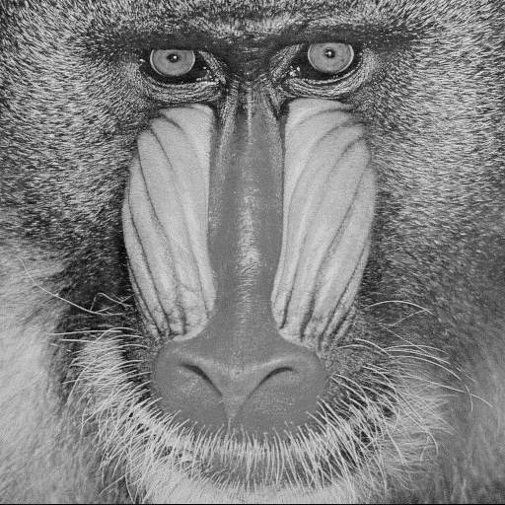
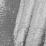
Introduction(2/6)
Clear image
(1.2)
p: noise probability | I(x, y): clear pixel
N: impulse noise | J(x, y): output pixel
Clear

Slide 6
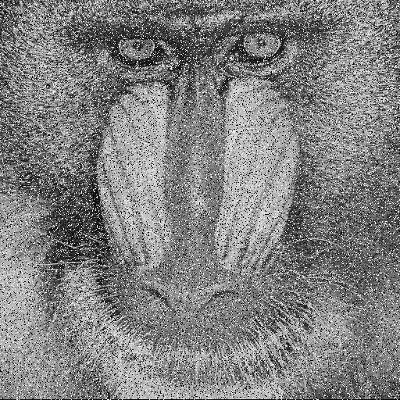

Introduction(3/6)
SPN (salt and pepper noise)
(1.2)
p: noise probability | I(x, y): clear pixel
N: 0 or 255 (8-bit) | J(x, y): output pixel
20% Salt and Pepper Noises (SPN)

Slide 7

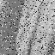
Introduction(4/6)
RVIN (random-value impulsive noise)
(1.2)
p: noise probability | I(x, y): clear pixel
N: 0 to 255 (8-bit) | J(x, y): output pixel
20% Random-Valued Impulse Noises (RVIN)

Slide 8
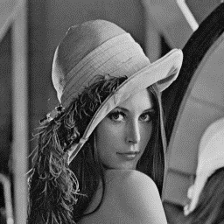
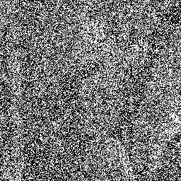
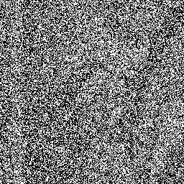
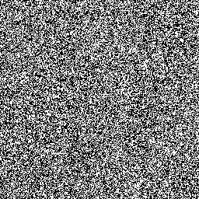
Introduction(5/6)
The Problems:
But these techniques usually fail to recover the corrupted image when the percentage of noise within an image is over 50%.
Origin(Lena)
70% Noise Image
80% Noise Image
90% Noise Image

Slide 9
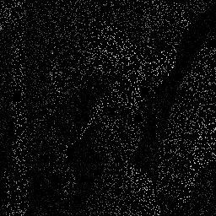
Introduction(6/6)
Reasons:
This is because, under such conditions, noise-free pixels are not sufficiently present within each cropped window to reconstruct the image.
Origin(Lena)
90% Noise Image
Noise-free pixels

Slide 10
Outline
I
Introduction
II
Previous Works
III
Proposed Method
IV
Experimental Results
V
Conclusions

Slide 11
Previous Works(1/9)
Filter-based methods:
Adaptive weighted mean filter (AWMF) [8]
Modified Decision Based Un-symmetric Trimmed Median Filter (MDBUTMF) [9]
Fast and Efficient Median Filter (FEMF) [10]
Noise adaptive fuzzy switching median filter (NAFSMF) [11]
Learning-based method:
De-Noising CNN (DnCNN) [12]

Slide 12
Previous Works(2/9)
Adaptive weighted mean filter (AWMF)
1
Window Ω has clear pixels?
Input pixel
Increase size of Ω
No
Ω =
39 × 39?
No
Yes
Yes
SPN detection
Simple averaging
Selected median calculation
0/1?
0
Output pixel

Slide 13
Previous Works(3/9)
Modified Decision Based Un-symmetric Trimmed Median Filter (MDBUTMF)
TYPE 1
TYPE 2
TYPE 3
43
67
70
43
67
70
255
0
0
55
90
79
55
0
79
255
255
0
85
81
66
85
81
66
0
0
255
TYPE 1: input clear pixel
Output clear pixel directly
TYPE 2: noise center pixel with clear neighbor pixels
Output simple median pixel in window Ω 3 × 3
TYPE 3: noise center pixel without clear neighbor pixels
Output simple average pixel in window Ω 3 × 3

Slide 14
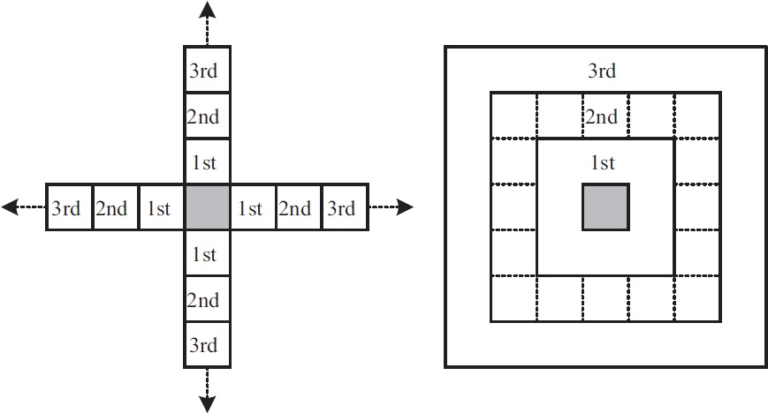
Previous Works(4/9)
Fast and Efficient Median Filter (FEMF)
If input pixel is clear then
Output clear pixel directly
else then
Increase window size of Ω until at least 1 clear neighbor pixel is founded
Output selected median pixel of Ω
Noise rate < 50%
Noise rate ≥ 50%

Slide 15
Previous Works(5/9)
Noise adaptive fuzzy switching median filter (NAFSMF)
1
Window Ω has clear pixels?
Input pixel
Increase size of Ω
No
Ω =
7 × 7?
No
Yes
SPN detection
Weighted median of window 3 × 3
Fuzzy averaging estimation
Selected median calculation
0/1?
0
Output pixel

Slide 16
Previous Works(6/9)
Noise adaptive fuzzy switching median filter (NAFSMF)
Weighted median of window 3 × 3
Select the above white pixels and calculate the median value to be output pixel

Slide 17
Previous Works(7/9)
Noise adaptive fuzzy switching median filter (NAFSMF)
Fuzzy averaging estimation
Find the max distance D between center and neighbor pixels in window 3 × 3.
Let x be the incoming pixel index.
Let I be input pixel value and M be median value.
(= 10)
(= 30)

Slide 18
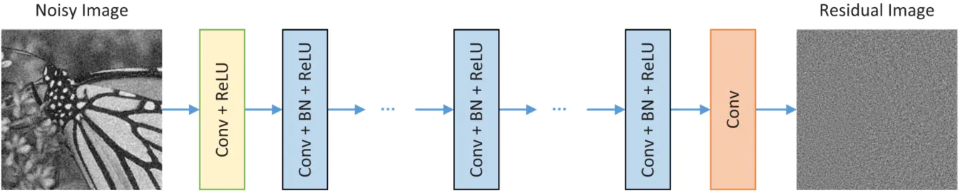
Previous Works(8/9)
De-Noising CNN (DnCNN)
1st Layer | filter 3 × 3 × c × 64 generating 64 feature maps
2nd Layer | filter 3 × 3 × 64 × 64 + BN generating 64 feature maps
3rd Layer | filter 3 × 3 × 64 × 64 + BN generating 64 feature maps
……
(D – 1)^{th} Layer | filter 3 × 3 × 64 × 64 + BN generating 64 feature maps
(D)^{th} Layer | filter 3 × 3 × 64 × c generating residual image
BN: Batch Normalization

Slide 19
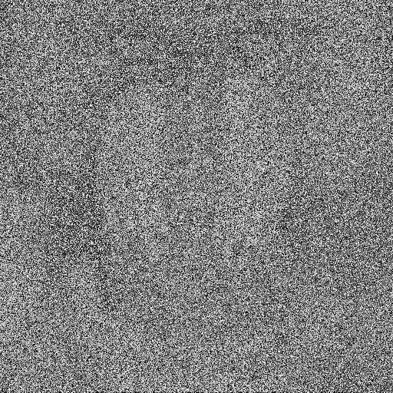
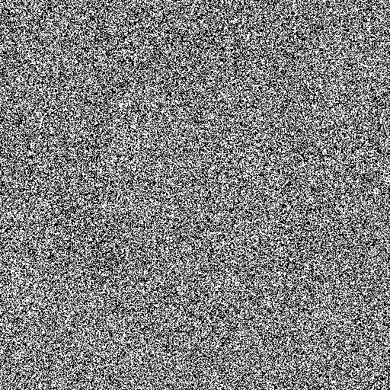
Previous Works(9/9)
The filter-based methods and learning-based methods are often inefficient if images are corrupted by high-density noise (e.g., containing more than 50% noise).
Clear
80% SPN
90% SPN

Slide 20
Outline
I
Introduction
II
Previous Works
III
Proposed Method
IV
Experimental Results
V
Conclusions

Slide 21
Proposed Method(1/23)
Proposed Method
Method 1
Method 2
Morphological Mean Filter (MMF)
For denoising method in the SPN suppression stage
Lightweight Denoising Network (LD-Net)
For denoising method in the RVIN suppression stage

Slide 22
Proposed Method(2/23)
Proposed Method
Method 1
Morphological Mean Filter (MMF)
For denoising method in the SPN suppression stage

Slide 23
Proposed MMF Method(3/23)
Morphological Mean Filter(MMF) architecture
Noise-free pixel counter (NPC) module
Morphological pixel dilation (MPD) module

Slide 24
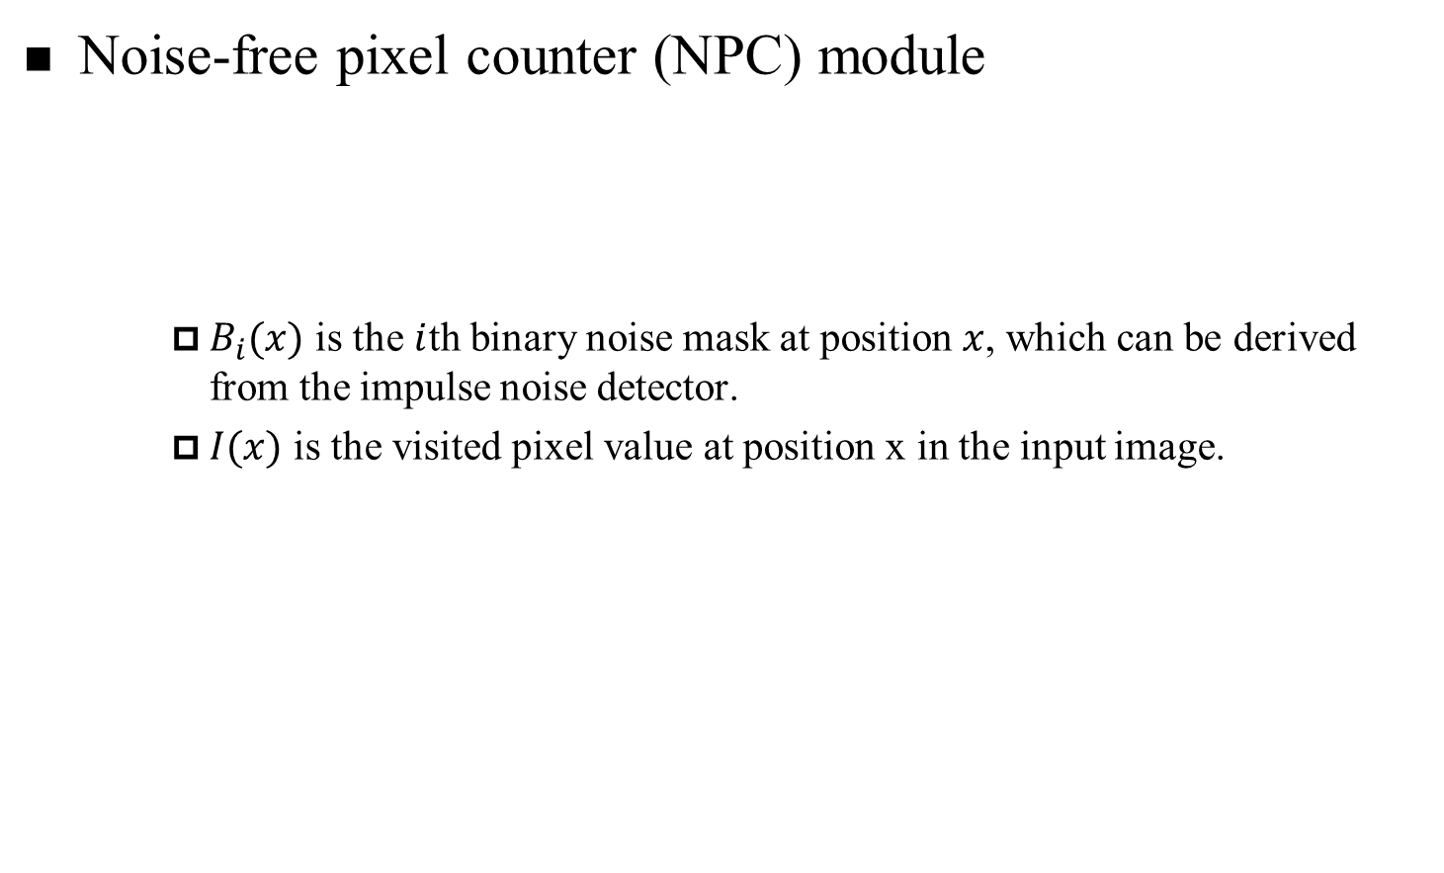
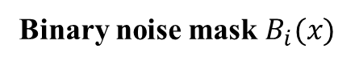
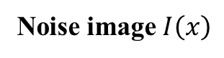
Proposed MMF Method(4/23)
Noise-free pixel counter (NPC) module
$B_{i}(x)$ is the $i$th binary noise mask at position $x$, which can be derived from the impulse noise detector.
$I(x)$ is the visited pixel value at position x in the input image.
$$B_{i}(x)=\left\{\begin{aligned}1, ifI\left(x\right) is \text{noise} \text{pixel} \\ 0, otherwise \end{aligned}\right. \left(2.1\right)$$
Noise image $I\left(x\right)$
The cropped patch of noise image
Binary noise mask $B_{i}(x)$
0
0
255
0
0
255
0
0
0
129
1
1
1
1
1
1
1
1
1
0
0
130
0
255
255
0
128
0
0
0
1
0
1
1
1
1
0
1
1
1
255
0
0
0
0
255
0
0
255
255
1
1
1
1
1
1
1
1
1
1
0
0
127
0
255
0
255
0
255
0
1
1
0
1
1
1
1
1
1
1
255
0
0
0
255
0
0
0
0
0
1
1
1
1
1
1
1
1
1
1
255
255
0
0
0
0
131
0
0
255
1
1
1
1
1
1
0
1
1
1

Slide 25
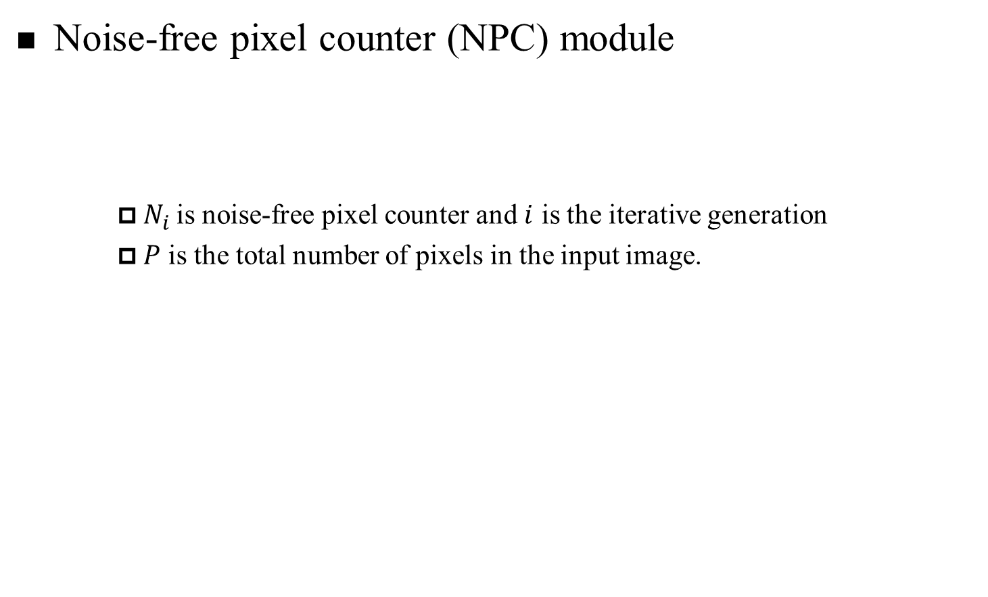
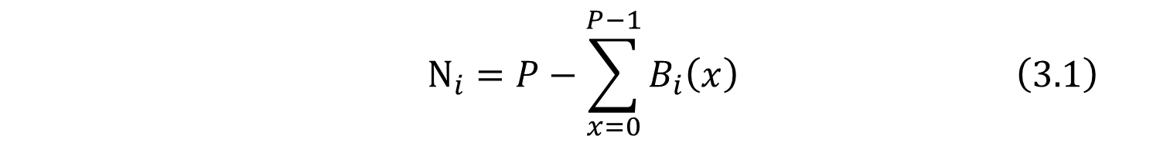
Proposed MMF Method(5/23)
Noise-free pixel counter (NPC) module
$N_{i}$ is noise-free pixel counter and $i$ is the iterative generation
$P$ is the total number of pixels in the input image.
$$N_{i}=P−\sum_{x=0}^{P−1}{B_{i}\left(x\right)} \left(3.1\right)$$
The cropped patch of noise image
0
0
255
0
0
255
0
0
0
129
0
130
0
255
255
0
128
0
0
0
The cropped patch of noise-free image
255
0
0
0
0
255
0
0
255
255
0
0
0
0
0
0
0
0
0
129
0
0
127
0
255
0
255
0
255
0
128
0
130
0
0
0
0
0
0
0
Binary noise mask
0
0
0
0
0
0
0
0
0
0
1
1
1
1
1
1
1
1
1
0
0
0
127
0
0
0
0
0
0
0
1
0
1
1
1
1
0
1
1
1
1
1
1
1
1
1
1
1
1
1
1
1
0
1
1
1
1
1
1
1

Slide 26


Proposed MMF Method(6/23)
Noise-free pixel counter (NPC) module
the total number of noise-free pixels
Noise-free image
of “F16”
The first cropped patch
The last cropped patch
0
0
0
0
0
0
0
0
0
129
0
0
0
0
0
0
0
0
0
0
0
130
0
0
0
0
128
0
0
0
0
0
0
130
0
0
0
0
0
0
0
0
0
0
0
0
0
0
0
0
0
0
0
0
0
0
0
129
0
0
0
0
127
0
0
0
0
0
0
0
0
131
0
0
0
0
0
0
0
0
0
0
0
0
0
0
0
0
0
0
0
0
0
0
0
0
0
0
128
0
0
0
0
0
0
0
131
0
0
0
0
0
0
0
0
127
0
0
0
0
0
0
0
133
0
0
0
0
0
0
133
0
0
0
0
0
0
0
0
0
0
0
0
0
0
0
0
0
129
0
0
0
130
131
129
0
0
0
0
0
0
0
130
0
0
0
0
0
0
0
0
0
0
0
0
0
0
0
0
0
0
$N_{1}=$8
$$N_{k}=9$$

Slide 27
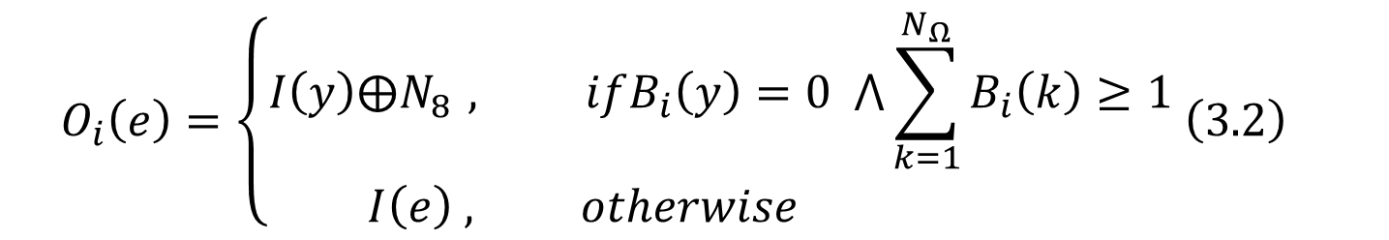
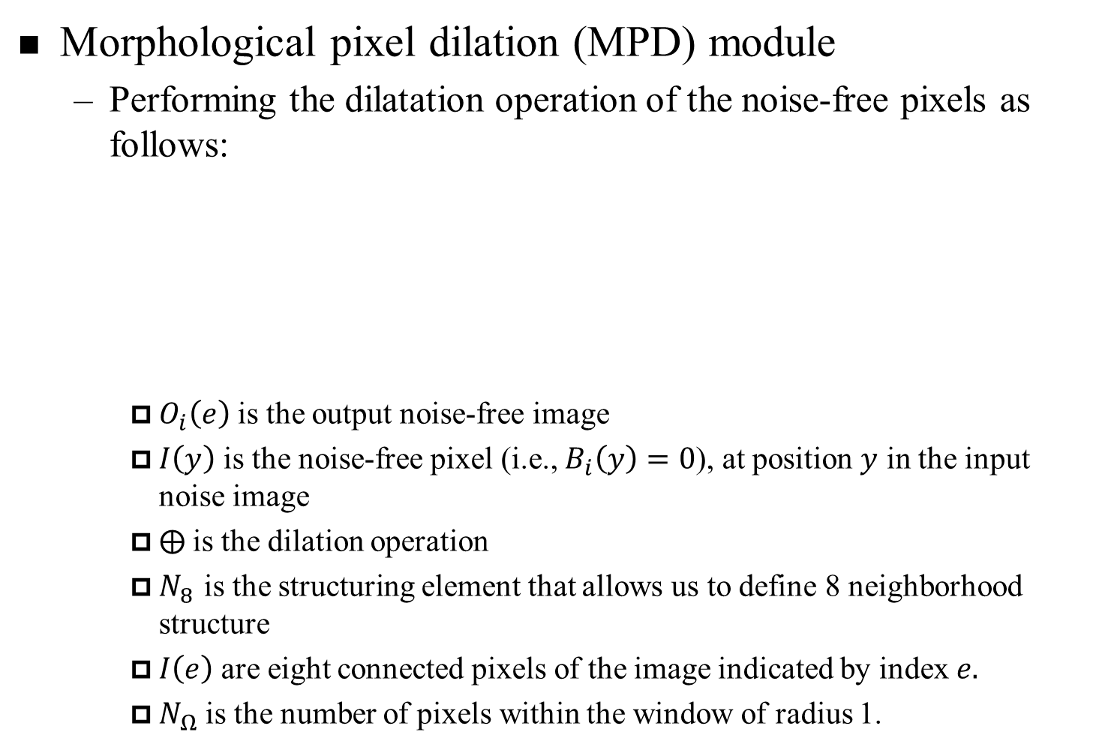
Proposed MMF Method(7/23)
Morphological pixel dilation (MPD) module
Performing the dilatation operation of the noise-free pixels as follows:
$O_{i}\left(e\right)$ is the output noise-free image
$I\left(y\right)$ is the noise-free pixel (i.e., $B_{i}\left(y\right)=0$), at position $y$ in the input noise image
⨁ is the dilation operation
$N_{8 }$is the structuring element that allows us to define 8 neighborhood structure
$I\left(e\right)$ are eight connected pixels of the image indicated by index $e.$
$N_{Ω}$ is the number of pixels within the window of radius 1.
$$O_{i}\left(e\right)=\left\{\begin{aligned}I\left(y\right)⨁N_{8 }, ifB_{i}\left(y\right)=0 ⋀\sum_{k=1}^{N_{Ω}}{B_{i}\left(k\right)≥1} \\ I\left(e\right) , otherwise \end{aligned} \left(3.2\right) \right.$$

Slide 28
Proposed MMF Method(8/23)
Morphological pixel dilation (MPD) module
Structuring element for the 8-neighborhood used in the proposed method.
$8 neighborhood structure{( N}_{8 }) and the window size is 3×3$ ($N_{Ω}$)

Slide 29
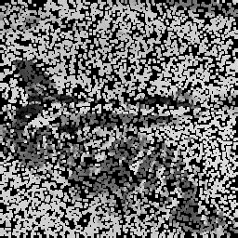
Proposed MMF Method(9/23)
Morphological pixel dilation (MPD) module
Performing the dilatation operation of the noise-free pixels
(130 + 128) / 2 = 129
The cropped patch
Dilation operation
Fill the result
130
130
130
127
127
127
130
127
130
127
130
130
130
127
127
127
130
129
129
128
127
127
127
128
128
128
128
128
128
128
128
131
131
131
131
131
131
131
131
131
131
131
Noise-free image of “F16”
Dilation operation
Reconstructed image

Slide 30
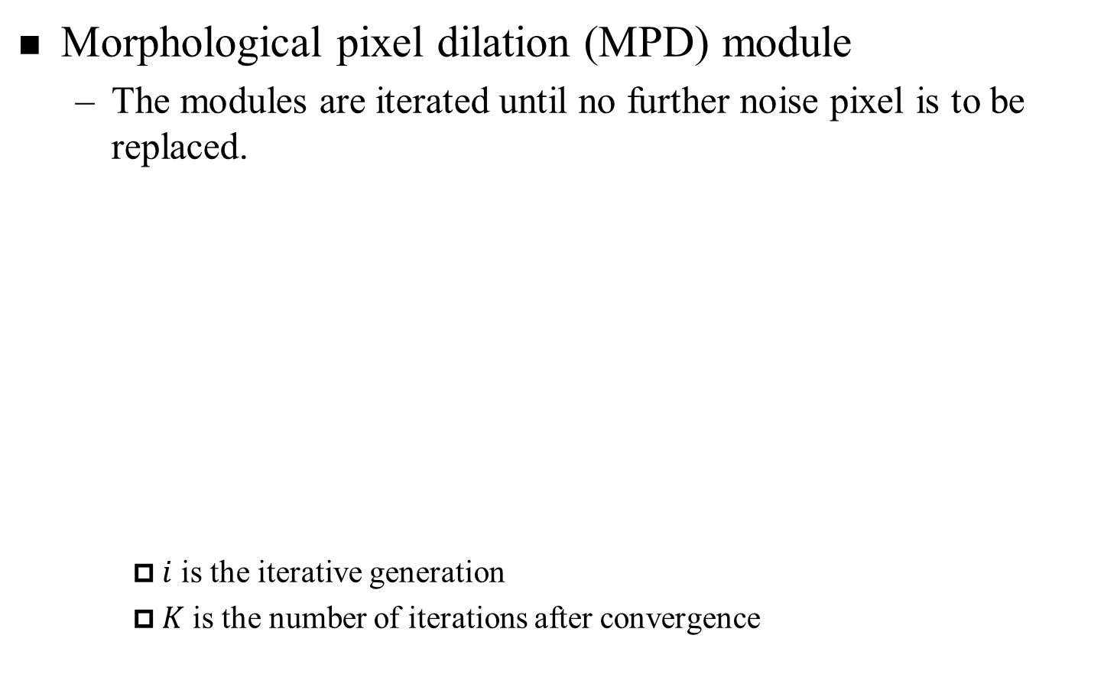
Proposed MMF Method(10/23)
Morphological pixel dilation (MPD) module
The modules are iterated until no further noise pixel is to be replaced.
$i$ is the iterative generation
$K$ is the number of iterations after convergence

Slide 31
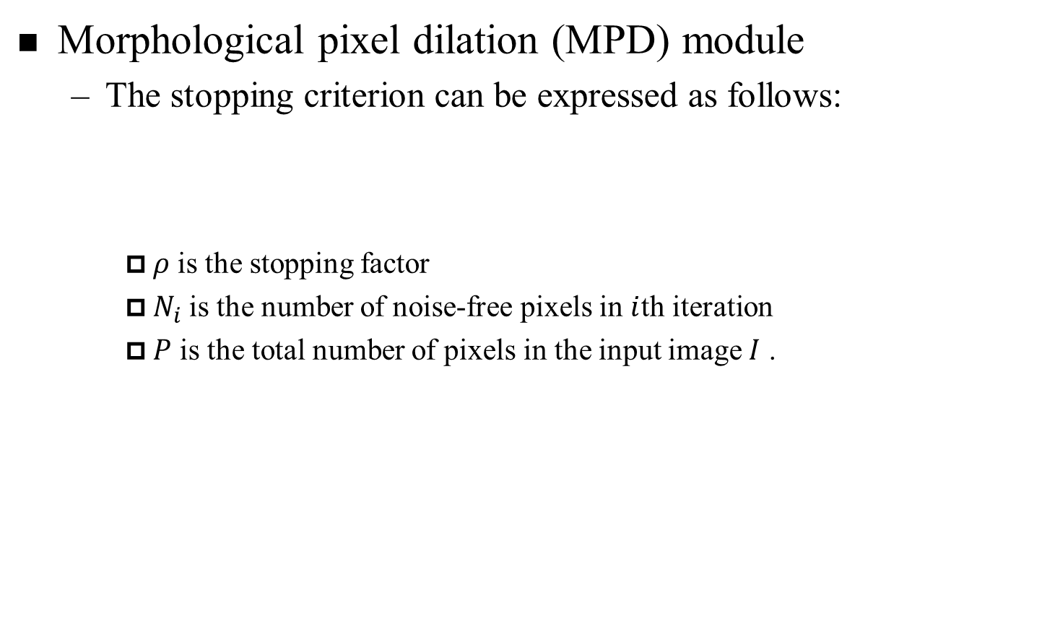
Proposed MMF Method(11/23)
Morphological pixel dilation (MPD) module
The stopping criterion can be expressed as follows:
$ρ$ is the stopping factor
$N_{i}$ is the number of noise-free pixels in $i$th iteration
$P$ is the total number of pixels in the input image $I$ .
$$ρ=1−\frac{N_{i}}{P} \left(3.3\right)$$

Slide 32
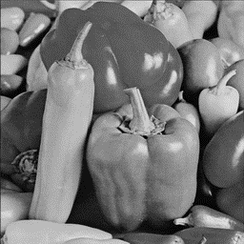
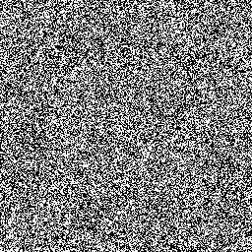


Proposed MMF Method(12/23)
Morphological pixel dilation (MPD) module
Stopping factor
Origin(Peppers)
Iteration = 2
$$ρ=0.1$$
PSNR = 15.99
90% Noise image
Iteration = 5
$$ρ=1e^{−5}$$
PSNR = 5.76
PSNR = 22.68

Slide 33
Proposed Method(13/23)
Proposed Method
Method 2
Lightweight Denoising Network (LD-Net)
For denoising method in the RVIN suppression stage

Slide 34
Proposed LD-Net Method(14/23)
Lightweight Denoising Network(LD-Net) architecture
Previous method
LD-Net method
Conv + ReLU
Conv + ReLU
Conv + ReLU
Conv + ReLU
Conv + ReLU
Conv + ReLU
Conv
Noise Image
Restored Image
Deconv + ReLU
Deconv + ReLU
Conv + ReLU
Conv + ReLU
Conv + ReLU
Conv
Noise Image
Restored Image

Slide 35
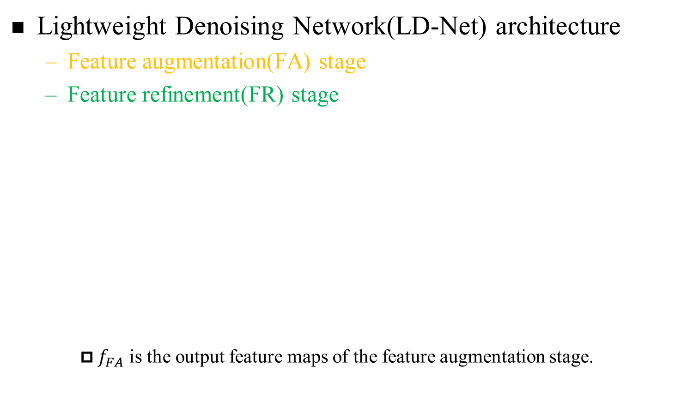
Proposed LD-Net Method(15/23)
Lightweight Denoising Network(LD-Net) architecture
Feature augmentation(FA) stage
Feature refinement(FR) stage
$f_{FA}$ is the output feature maps of the feature augmentation stage.
The diagram of the proposed LD-Net

Slide 36
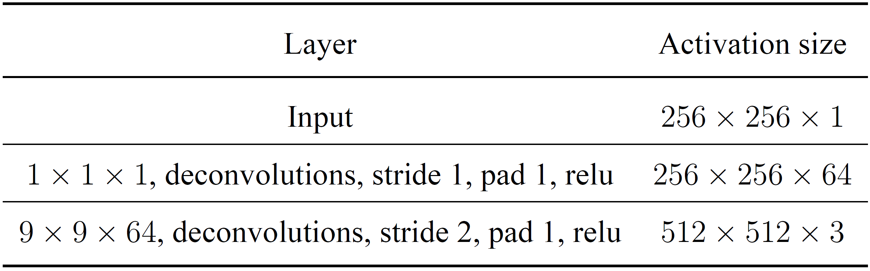
Proposed LD-Net Method(16/23)
Feature augmentation(FA) stage
To effectively extract and learn features for noise removal, the spatial sizes and dimensions of the input image are first enlarged by the deconvolution layers.
Table 3.1: Setting of the proposed image augmentation module

Slide 37
Proposed LD-Net Method(17/23)
Feature augmentation(FA) stage
The purpose of increasing the dimension.
1*1*1 kernel filter * 64
256
1
256
256
1
1
1
256
64
input image
activation maps
45
81
Stride 1
45
54
90
45
81
81
45
81
1
45
81
54
90
54
90
54
90
64
54
90
Example patch
1*1 activation maps
Example patch

Slide 38
Proposed LD-Net Method(18/23)
Feature augmentation(FA) stage
The layer Deconvolutional to enlarge their resolution.
256
1
9*9*64 kernel filter * 3
512
256
1
1
1
1
1
512
64
3
activation maps
activation maps
45
126
81
…
45
126
81
…
45
0
81
0
45
126
81
…
Stride 2
99
198
171
…
99
198
171
…
0
0
0
0
99
198
171
…
45
81
1
…
54
144
90
…
54
144
90
…
54
90
54
0
90
0
…
54
144
90
…
…
…
…
…
…
…
…
…
…
0
0
0
0
3
…
…
…
…
Example patch
9*9 activation maps
Example patch

Slide 39
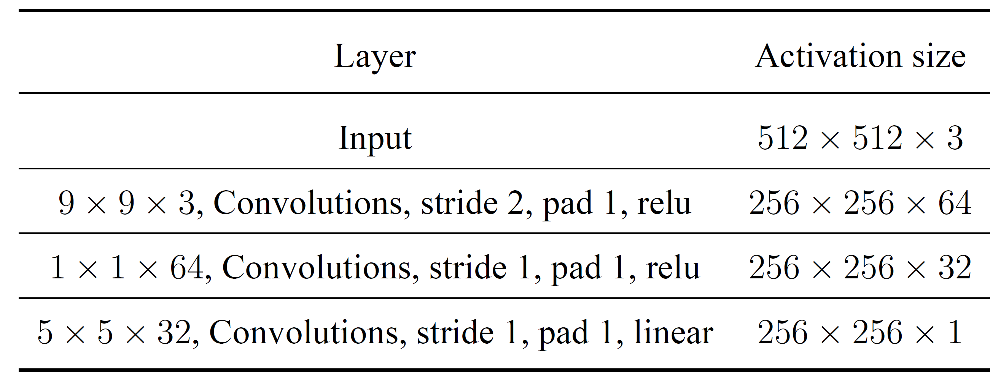
Proposed LD-Net Method(19/23)
Feature refinement(FR) stage
During the feature refinement stage, the boundary artifacts are reduced and textural information is enhanced for the efficient reconstruction of a noise-free image
Table 3.2: Setting of the proposed image refinement module

Slide 40
Proposed LD-Net Method(20/23)
Feature refinement(FR) stage
The layer convolutional extract useful features for image.
9*9*3 kernel filter * 64
256
1
512
1
256
1
1
1
1
512
3
64
activation maps
activation maps
43
72
90
45
0
81
…
45
0
81
…
83
176
156
0
45
0
81
…
0
0
…
43
0
0
0
…
56
120
87
72
90
0
0
0
…
43
72
90
54
0
90
…
1
…
83
176
54
0
90
…
83
156
…
54
0
90
…
176
156
…
…
…
…
…
56
120
87
…
…
…
…
64
56
120
87
3
…
…
…
…
Example patch
9*9 activation maps
Example patch

Slide 41
Proposed LD-Net Method(21/23)
Feature refinement(FR) stage
The layer convolutional extract useful features for image.
256
1
1*1*64 kernel filter * 32
256
1
256
1
256
1
1
1
64
32
activation maps
activation maps
43
72
90
83
176
156
43
90
56
120
43
72
90
56
87
87
43
72
90
83
176
156
1
43
90
83
176
156
43
90
56
120
87
56
87
64
56
120
87
32
56
87
Example patch
1*1 activation maps
Example patch

Slide 42
Proposed LD-Net Method(22/23)
Feature refinement(FR) stage
The layer convolutional extract useful features for image.
256
1
5*5*32 kernel filter *1
256
1
256
1
1
256
32
activation maps
output image
43
90
56
87
43
90
1
45
81
43
90
56
87
54
90
64
56
87
Example patch
5*5 activation maps
Example patch

Slide 43
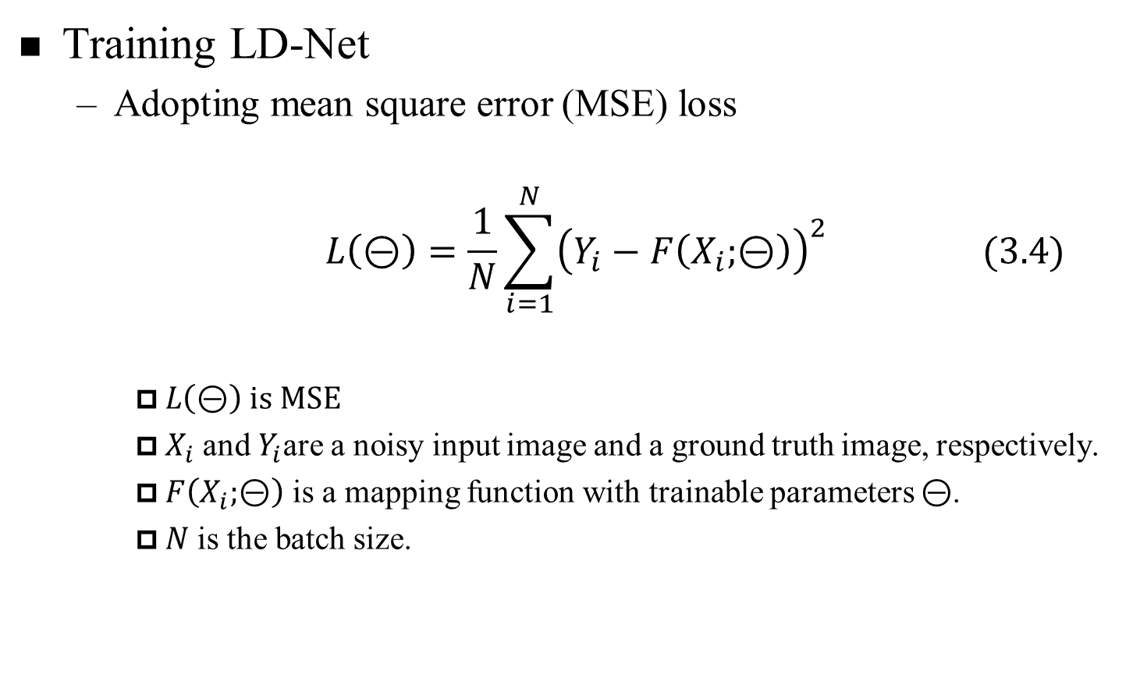
Proposed LD-Net Method(23/23)
Training LD-Net
Adopting mean square error (MSE) loss
$$L\left(⊝\right)=\frac{1}{N}\sum_{i=1}^{N}{{\left(Y_{i}−F\left(X_{i};⊝\right)\right)}^{2} (3.4)}$$
$L\left(⊝\right)$ is MSE
$X_{i}$ and $Y_{i}$are a noisy input image and a ground truth image, respectively.
$F\left(X_{i};⊝\right)$ is a mapping function with trainable parameters $⊝$.
$N$ is the batch size.

Slide 44
Outline
I
Introduction
II
Previous Works
III
Proposed Method
IV
Experimental Results
V
Conclusions

Slide 45
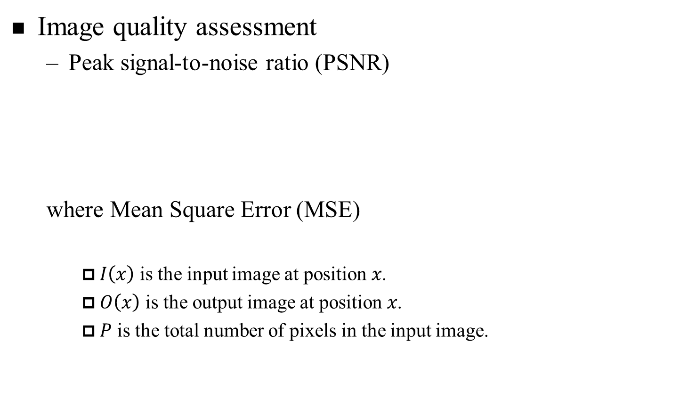
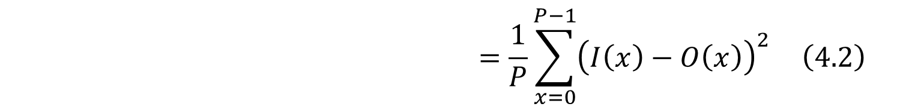
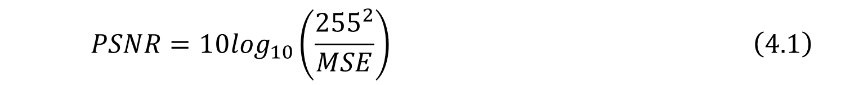
Experimental results(1/11)
Image quality assessment
Peak signal-to-noise ratio (PSNR)
where Mean Square Error (MSE)
$I\left(x\right)$ is the input image at position 𝑥.
$O\left(x\right)$ is the output image at position 𝑥.
$P$ is the total number of pixels in the input image.
$$PSNR=10\log_{10}\left(\frac{{255}^{2}}{MSE}\right) \left(4.1\right)$$
$$=\frac{1}{P}\sum_{x=0}^{P−1}{{\left(I\left(x\right)−O\left(x\right)\right)}^{2}} \left(4.2\right)$$

Slide 46
Experimental results(2/11)
4.1 Results and Discussion of The MMF
Performance Comparison of MMF and Combination Model
Test image
We select three 256 x 256 standard grayscale images entitled "Peppers", "Aircraft", and "F16" for testing the NAFSM, MDBUTM, AWM and our MM methods.
Device
Each test image was corrupted by 90% noise density and restoration was conducted with MATLAB 2013b running on a desktop machine with a Windows 8.1 operating system and an Intel Core i7 Quad central processing unit at 2.40 GHz and 16 GB memory.

Slide 47
Experimental results(3/11)
4.1 Results and Discussion of The MMF
Denoising of the "Peppers" image

Slide 48
Experimental results(4/11)
4.1 Results and Discussion of The MMF
Denoising of the "Aircraft" image

Slide 49
Experimental results(5/11)
4.1 Results and Discussion of The MMF
Denoising of the "F16" image

Slide 50
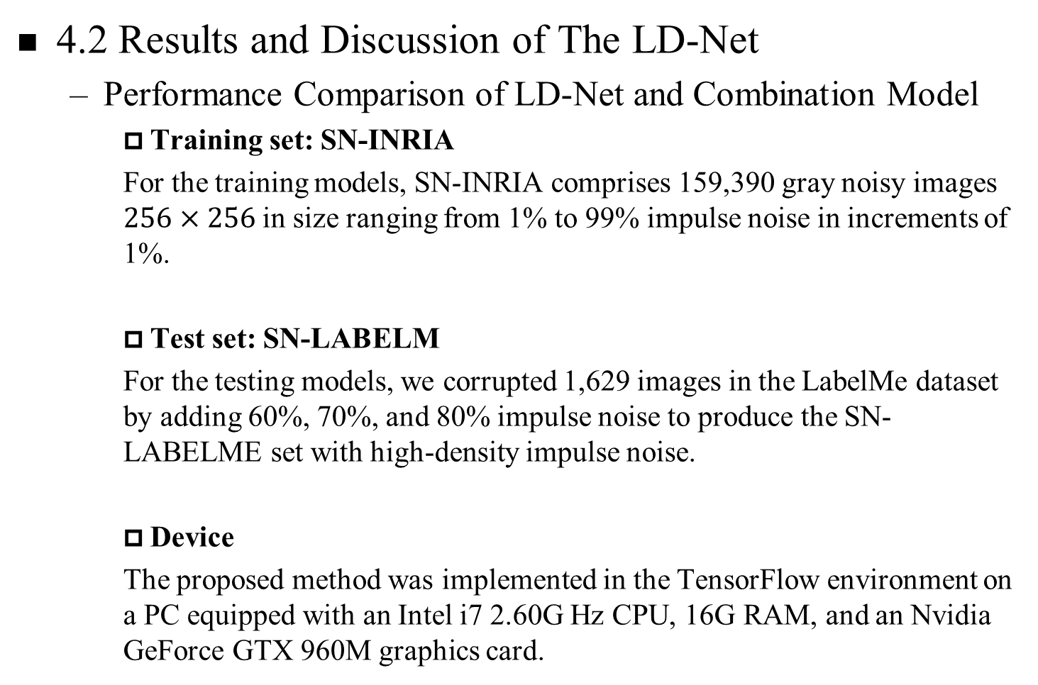
Experimental results(6/11)
4.2 Results and Discussion of The LD-Net
Performance Comparison of LD-Net and Combination Model
Training set: SN-INRIA
For the training models, SN-INRIA comprises 159,390 gray noisy images $256×256$in size ranging from 1% to 99% impulse noise in increments of 1%.
Test set: SN-LABELM
For the testing models, we corrupted 1,629 images in the LabelMe dataset by adding 60%, 70%, and 80% impulse noise to produce the SN-LABELME set with high-density impulse noise.
Device
The proposed method was implemented in the TensorFlow environment on a PC equipped with an Intel i7 2.60G Hz CPU, 16G RAM, and an Nvidia GeForce GTX 960M graphics card.

Slide 51
Experimental results(7/11)
4.2 Results and Discussion of The LD-Net
Denoising results of LD-Net and other denoising methods on a " Forest" image with 60% impulse noise corruptions.

Slide 52
Experimental results(8/11)
4.2 Results and Discussion of The LD-Net
Denoising results of LD-Net and other denoising methods on a " cameraman" image with 70% impulse noise corruptions.

Slide 53
Experimental results(9/11)
4.2 Results and Discussion of The LD-Net
Denoising results of LD-Net and other denoising methods on a " Boat" image with 80% impulse noise corruptions.

Slide 54
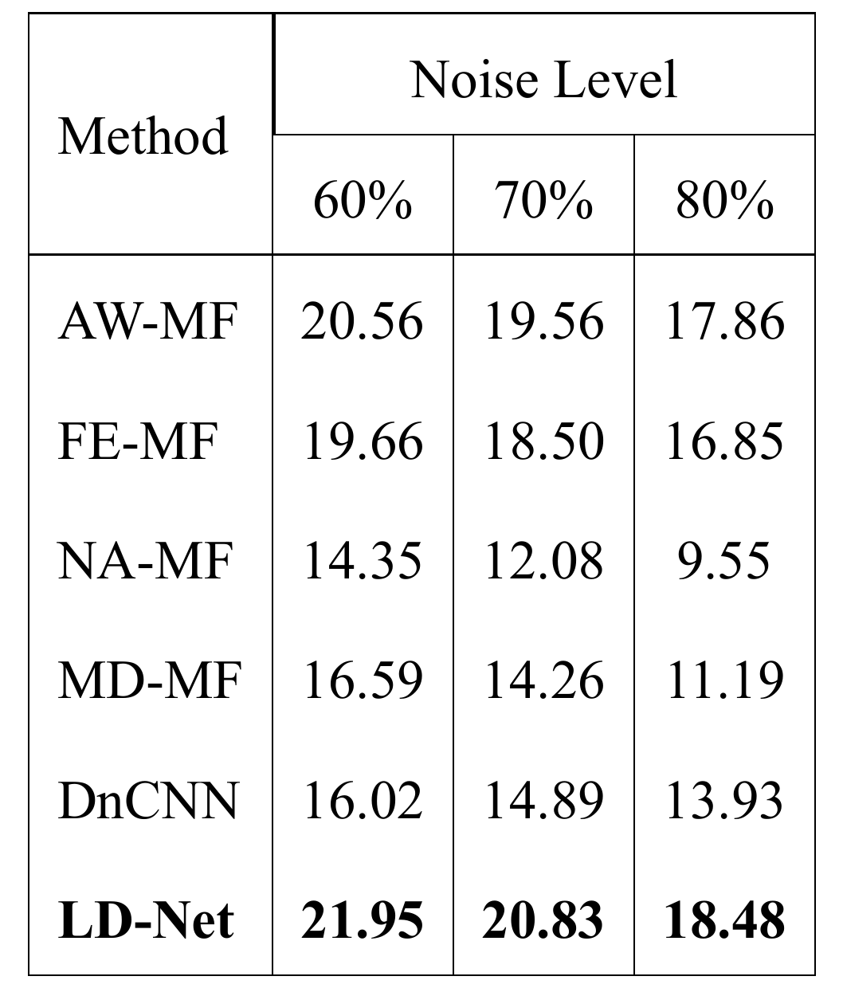
Experimental results(10/11)
4.2 Results and Discussion of The LD-Net
Table 4.2: Average PSNR (dB)

Slide 55
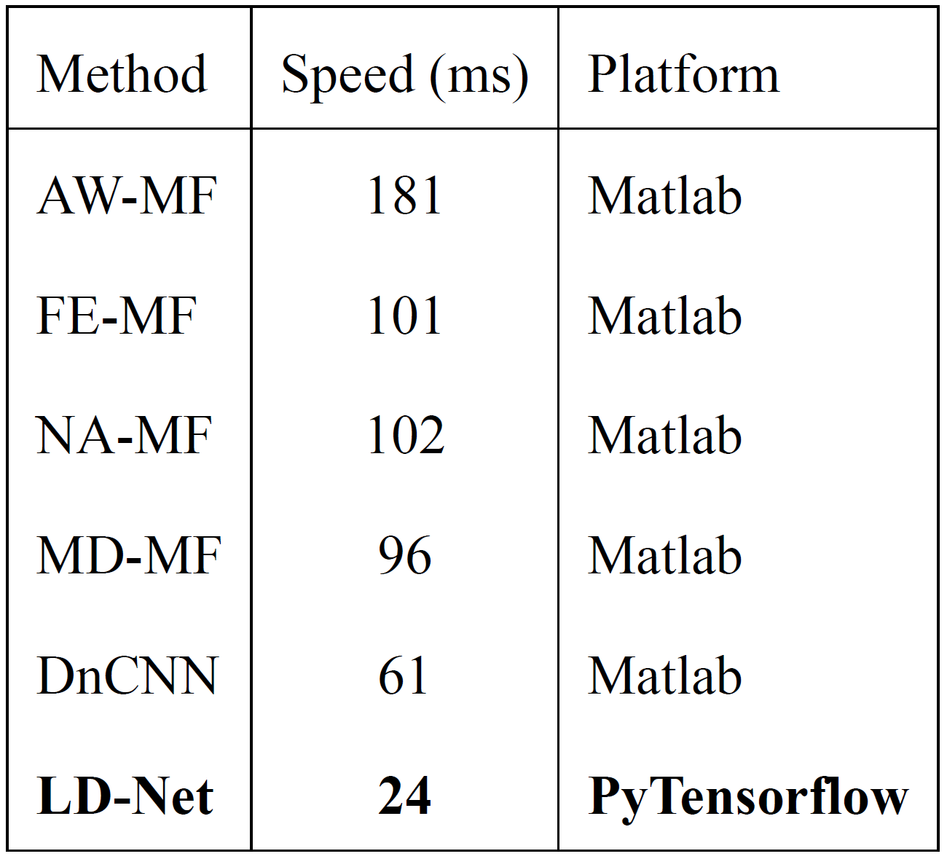
Experimental results(11/11)
4.2 Results and Discussion of The LD-Net
Table 4.3: Running time

Slide 56
Outline
I
Introduction
II
Previous Work
III
Proposed Methods
IV
Experimental Results
V
Conclusions

Slide 57
Conclusions
We propose two new denoising methods, called Morphological Mean Filter(M-MF) and Lightweight Denoising Network(LD-Net).
MMF method employs a clear pixel based denoising model to the dilatation operation of these pixels is performed to fill into the neighbor noise pixels.
LD-Net method uses the deconvolution operations to seek a better reconstruction result through the uncorrupted features for high-density impulse noise removal.
Experimental results indicate that the proposed method more effectively removes high-density impulse noise in corrupted images.

Slide 58
References
[1] W. Min, M. Fan, X. Guo, and Q. Han, “A new approach to track multiple vehicles with the combination of robust detection and two classifiers,” IEEE Transactions on Intelligent Transportation Systems, vol. 19, pp. 174–186, Jan 2018.
[2] S.C. Huang, “An advanced motion detection algorithm with video quality analysis for video surveillance systems,” IEEE transactions on circuits and systems for video technology, vol. 21, pp. 1–14, Jan 2011.
[3] T.H. Le, S.C. Huang, and D.W. Jaw, “Crossresolution feature fusion for fast hand detection in intelligent homecare systems,” IEEE Sensors Journal, vol. 19, pp. 4696–4704, June 2019.
[4] S. Huang, T. Le, and D. Jaw, “Dsnet: Joint semantic learning for object detection in inclement weather conditions,” IEEE Transactions on Pattern Analysis and Machine Intelligence, pp. 1–1, March 2020.
[5] T.H. Le, D.W. Jaw, I.C. Lin, H.B. Liu, and S.C. Huang, “An efficient hand detection method based on convolutional neural network,” 2018 7th International Symposium on Next Generation Electronics (ISNE), pp. 1–2, May 2018.
[6] S. Anwar, F. Porikli, and C. P. Huynh, “Categoryspecific object image denoising,” IEEE Transactions on Image Processing, vol. 26, pp. 5506–5518, July 2017.
[7] F. Wang, H. Huang, and J. Liu, “Variationalbased mixed noise removal with cnn deep learning regularization,” IEEE Transactions on Image Processing, vol. 29, pp. 1246–1258, September 2019.
[8] P. Zhang and F. Li, “A new adaptive weighted mean filter for removing saltandpepper noise,” IEEE signal pr
[9] M.H. Hsieh, F.C. Cheng, M.C. Shie, and S.J. Ruan, “Fast and efficient median filter for removing 199% levels of saltandpepper noise in images,” Engineering Applications of Artificial Intelligence, vol. 26, pp. 1333–1338, April 2013.
[10] K. K. V. Toh and N. A. M. Isa, “Noise adaptive fuzzy switching median filter for saltandpepper noise reduction,” IEEE signal processing letters, vol. 17, pp. 281–284, March 2009.ocessing letters, vol. 21, pp. 1280–1283, June 2014.

Slide 59
References
[11] S. Esakkirajan, T. Veerakumar, A. N. Subramanyam, and C. PremChand, “Removal of high density salt and pepper noise through modified decision based unsymmetric trimmed median filter,” IEEE signal processing letters, vol. 18, pp. 287–290, May 2011.
[12] K. Zhang, W. Zuo, Y. Chen, D. Meng, and L. Zhang, “Beyond a gaussian denoiser: Residual learning of deep cnn for image denoising,” IEEE Transactions on Image Processing, vol. 26, pp. 3142–3155, July 2017.
[13] J. Xu, L. Zhang, W. Zuo, D. Zhang, and X. Feng, “Patch group based nonlocal selfsimilarity prior learning for image denoising,” Proceedings of the IEEE international conference on computer vision, pp. 244–252, 2015.
[14] T. Nodes and N. Gallagher, “Median filters: Some modifications and their properties,” IEEE Transactions on Acoustics, Speech, and Signal Processing, vol. 30, pp. 739–746, October 1982.
[15] ChungBin Wu, BinDa Liu, and JarFerr Yang, “A fuzzybased impulse noise detection and cancellation for realtime processing in video receivers,” IEEE Transactions on Instrumentation and Measurement, vol. 52, pp. 780–784, June 2003.
[16] S. Schulte, M. Nachtegael, V. De Witte, D. Van der Weken, and E. E. Kerre, “A fuzzy impulse noise detection and reduction method,” IEEE Transactions on Image Processing, vol. 15, pp. 1153–1162, May 2006.
[17] PeiEng Ng and KaiKuang Ma, “A switching median filter with boundary discriminative noise detection for extremely corrupted images,” IEEE Transactions on Image Processing, vol. 15, pp. 1506– 1516, June 2006.
[18] F. Duan and Y. Zhang, “A highly effective impulse noise detection algorithm for switching median filters,” IEEE Signal Processing Letters, vol. 17, pp. 647–650, July 2010.
[19] Yiqiu Dong, Raymond H. Chan, and Shufang Xu, “A detection statistic for randomvalued impulse noise,” IEEE Transactions on Image Processing, vol. 16, pp. 1112–1120, March 2007.
[20] P. Civicioglu, “Removal of randomvalued impulsive noise from corrupted images,” IEEE Transactions on Consumer Electronics, vol. 55, pp. 2097–2104, November 2009.

Slide 60
References
[21] Amarjit Roy, Lalit Manam, and Rabul Hussain Laskar, “Region adaptive fuzzy filter: An approach for removal of randomvalued impulse noise,” IEEE Transactions on Industrial Electronics, vol. 65, pp. 7268–7278, January 2018.
[22] Y.Y. Zhou and Z.F. Yeand J.J. Huang, “Improved decisionbased detailpreserving variational method for removal of randomvalued impulse noise,” IET Image Processing, vol. 6, pp. 976–985, October 2012.
[23] J. Xu, L. Zhang, and D. Zhang, “External prior guided internal prior learning for realworld noisy image denoising,” IEEE Transactions on Image Processing, vol. 27, no. 6, pp. 2996–3010, 2018.
[24] K. Simonyan and A. Zisserman, “Very deep convolutional networks for largescale image recognition,” 3rd International Conference on Learning Representations, ICLR 2015, San Diego, CA, USA, May 79, 2015, Conference Track Proceedings, vol. Y. Bengio and Y. LeCun, Eds, no. Available: http://arxiv.org/abs/1409.1556, 2015.
[25] J. Long, E. Shelhamer, and T. Darrell, “Fully convolutional networks for semantic segmentation,” Proceedings of the IEEE conference on computer vision and pattern recognition, pp. 3431–3440, 2015.
[26] M. D. Zeiler, D. Krishnan, G. W. Taylor, and R. Fergus, “Deconvolutional networks,” The TwentyThird IEEE Conference on Computer Vision and Pattern Recognition, vol. CVPR 2010, San Francisco, CA, USA, 1318 June 2010, no. Available: https://doi.org/10.1109/CVPR.2010.5539957, 2010.
[27] H. Noh, S. Hong, and B. Han, “Learning deconvolution network for semantic segmentation,” Proceedings of the IEEE international conference on computer vision, pp. 1520–1528, Dec 2015.
[28] M. D. Zeiler and R. Fergus, “Visualizing and understanding convolutional networks,” European conference on computer vision, pp. 818–833, 2014.
[29] H. C. Burger, C. J. Schuler, and S. Harmeling, “Image denoising: Can plain neural networks compete with bm3d?,” 2012 IEEE conference on computer vision and pattern recognition, pp. 2392–2399, 2012.
[30] U. Schmidt and S. Roth, “Shrinkage fields for effective image restoration,” 2014 IEEE Conference on Computer Vision and Pattern Recognition, pp. 2774–2781, June 2014.

Slide 61
References
[31] Y. Chen and T. Pock, “Trainable nonlinear reaction diffusion: A flexible framework for fast and effective image restoration,” IEEE transactions on pattern analysis and machine intelligence, vol. 39, pp. 1256–1272, June 2016.
[32] H. Jegou, M. Douze, and C. Schmid, “Hamming embedding and weak geometric consistency for large scale image search,” European conference on computer vision, pp. 304–317, 2008.
[33] B. C. Russell, A. Torralba, K. P. Murphy, and W. T. Freeman, “Labelme: a database and webbased tool for image annotation,” International journal of computer vision, vol. 77, no. 13, pp. 157–173, 2008.
[34] D. P. Kingma and J. Ba, “Adam: A method for stochastic optimization,” arXiv preprint arXiv: 1412.6980, 2014. 37

Slide 62
Q & A
Thanks for your attention!

